Slide 1
Chapter 4
E-environment

Slide 2
Learning outcomes
Identify the different elements of an organization macro-environment that impact on an organization e-business and
e-marketing strategy
Assess the impact of legal, privacy and ethical constraints or opportunities on a company
Assess the role of macro-economic factors such as governmental e-business policies, economics, taxation and legal constraints.

Slide 3
Management issues
What are the constraints placed on developing and implementing an e-business strategy by the
e-environment?
What factors influence the adoption of new digital media and how can we estimate future demand for online services?
How trust and privacy can be assured for the customer while seeking to achieve marketing objectives of customer acquisition and retention?

Slide 4
Activity 4.1
List all the social, legal and ethical issues that the manager of a sell-side e-commerce web site needs to consider to avoid damaging relationships with users of his or her site or which may leave the company facing prosecution. You can base your answer on issues which may concern you, your friends or your family when accessing a web site.

Slide 5
Activity answer – this lecture
Cookies – laws and consumer perception on placing these
Are we limiting access to information from certain sections of society (social exclusion)?
Privacy of personal information entered on a web site
Sending unsolicited e-mail
Replying promptly to e-mail
Copyright
Site content and promotional offers/adverts are in keeping with the different laws in different countries
Providing text, graphics and personality in keeping with social mores of different countries

Slide 6
SLEPT Factors
Macro-environment
  Social
  Legal
  Economic
  Political
  Technological

Slide 7
SLEPT Factors
Macro-environment
Imagine you operate an online clothing store in Bangladesh.
Customers' shopping habits affect your sales (….).
You must protect customers' personal information (….).
Inflation may reduce customers' purchasing power (….).
Government policies may affect your business (….).
Better mobile apps and payment technologies can improve your business (…..).

Slide 8
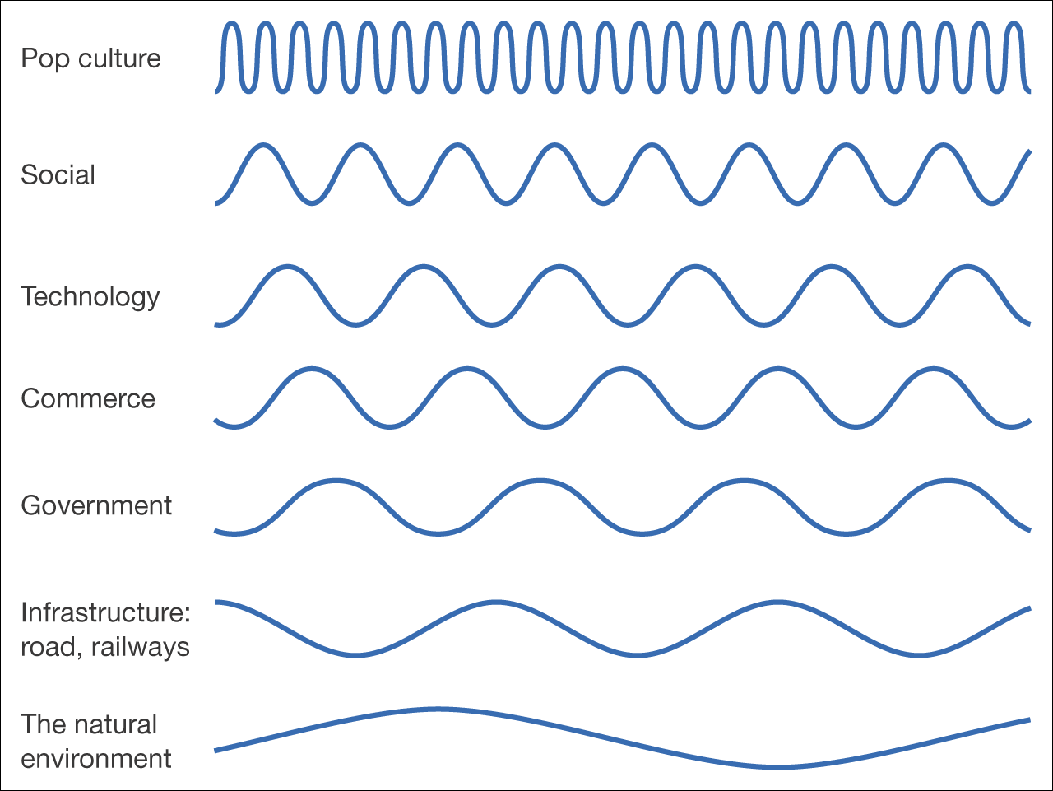
Figure 4.1 ‘Waves of change’ – different timescales for change in the environment

Slide 9
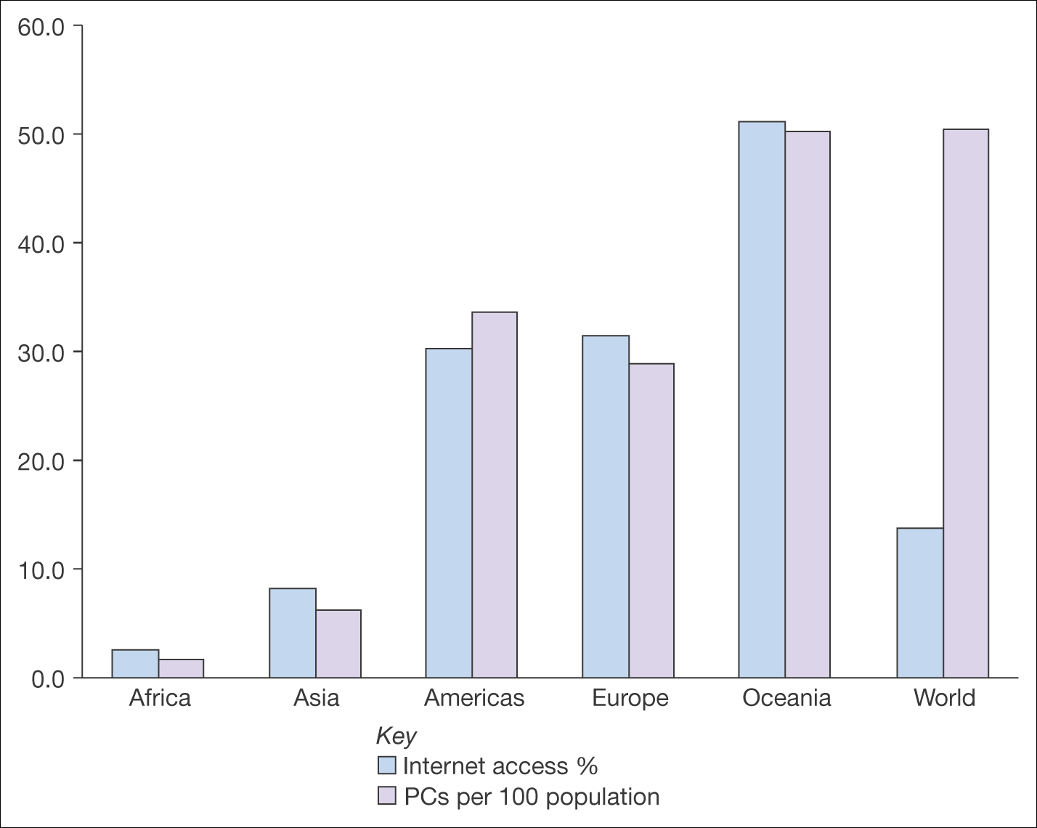
Figure 4.2 Global variation in number of PCs per hundred population and percentage Internet access in 2004
Source: ITU (www.itu.int/ITU-D/ict/statistics/)

Slide 10
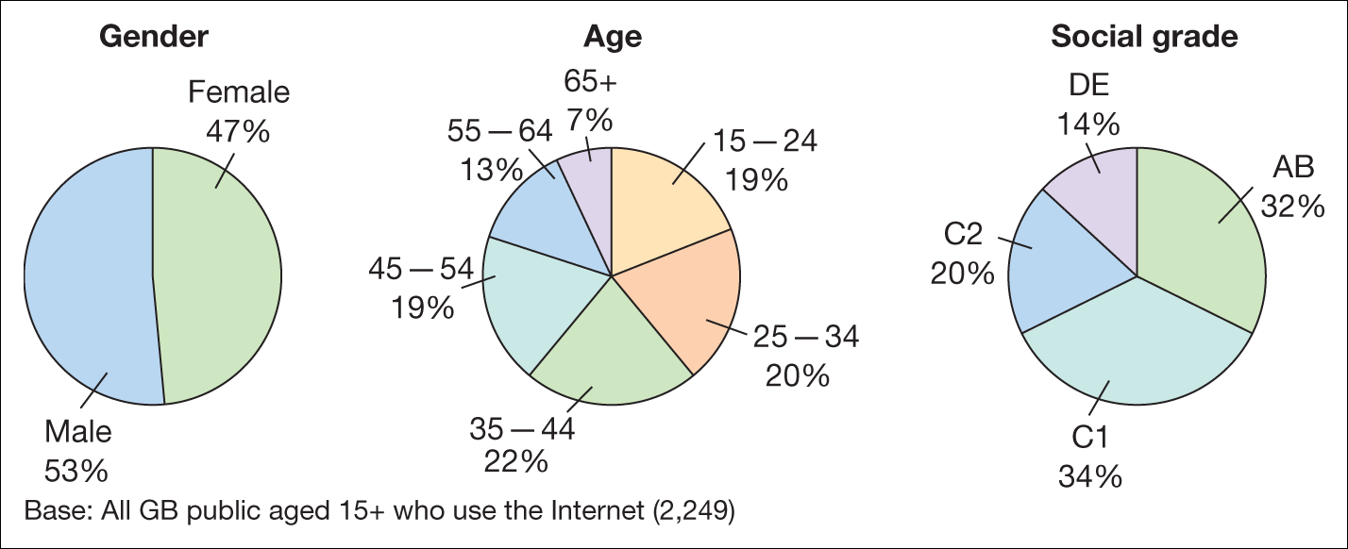
Figure 4.3 Variation in demographic characteristics of UK Internet users: (a) gender, (b) age, (c) social grade
Source: eMori Technology Tracker – www.mori.com/technology/trackerdata.shtml

Slide 11
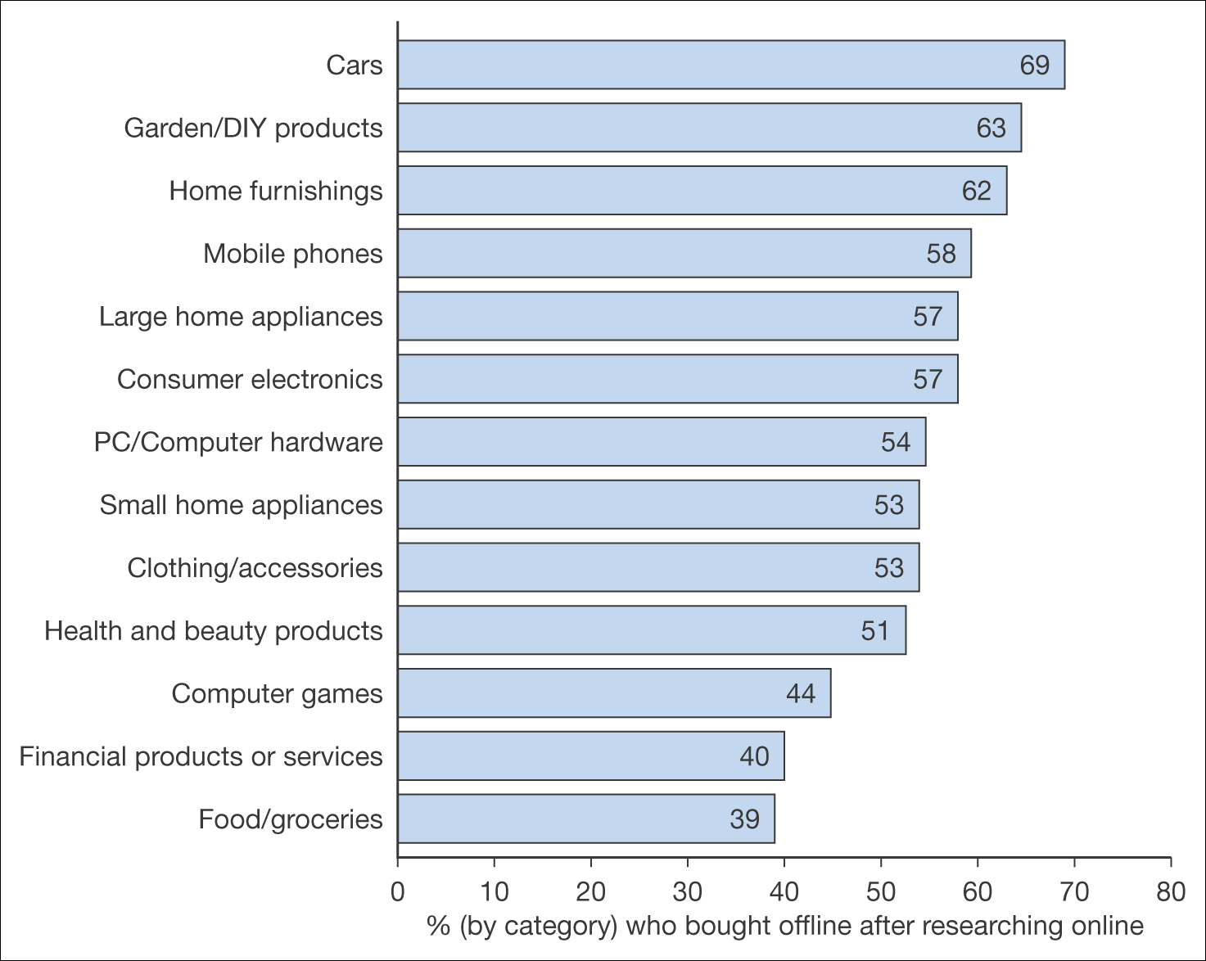
Figure 4.4 Percentage by category who bought offline after researching online
Source: BrandNewWorld: AOL UK / Anne Molen (Cranfield School of Management) / Henley Centre, 2004

Slide 12
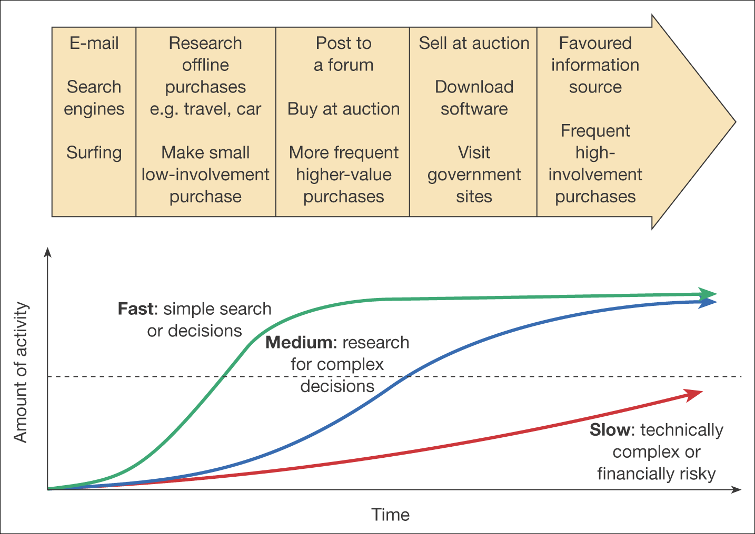
Figure 4.5 Development of experience in Internet usage

Slide 13
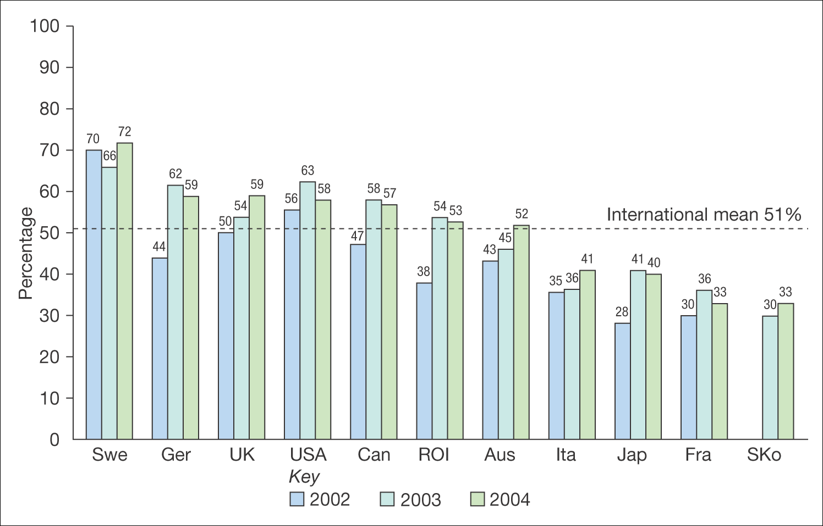
Figure 4.6 Percentage of businesses that order online
Source: DTI (2004), Fig 7.3a

Slide 14
Ethical issues and data protection
Ethical issues concerned with personal information ownership have been usefully summarized by Mason (1986) into four areas:
Privacy – what information is held about the individual?
Accuracy – is it correct?
Property – who owns it and how can ownership be transferred?
Accessibility – who is allowed to access this information, and under which conditions?

Slide 15
Ethics – Fletcher’s view
Fletcher (2001) provides an alternative perspective, raising these issues of concern for both the individual and the marketer:
Transparency – who is collecting what information?
Security – how is information protected once collected by a company?
Liability – who is responsible if data is abused?

Slide 16
The eight principles for data protection
Fairly and lawfully processed;
Processed for limited purposes;
Adequate, relevant and not excessive;
Accurate;
Not kept longer than necessary;
Processed in accordance with the data subject's rights;
Secure;
Not transferred to countries without adequate protection.
www.dataprotection.gov.uk

Slide 17
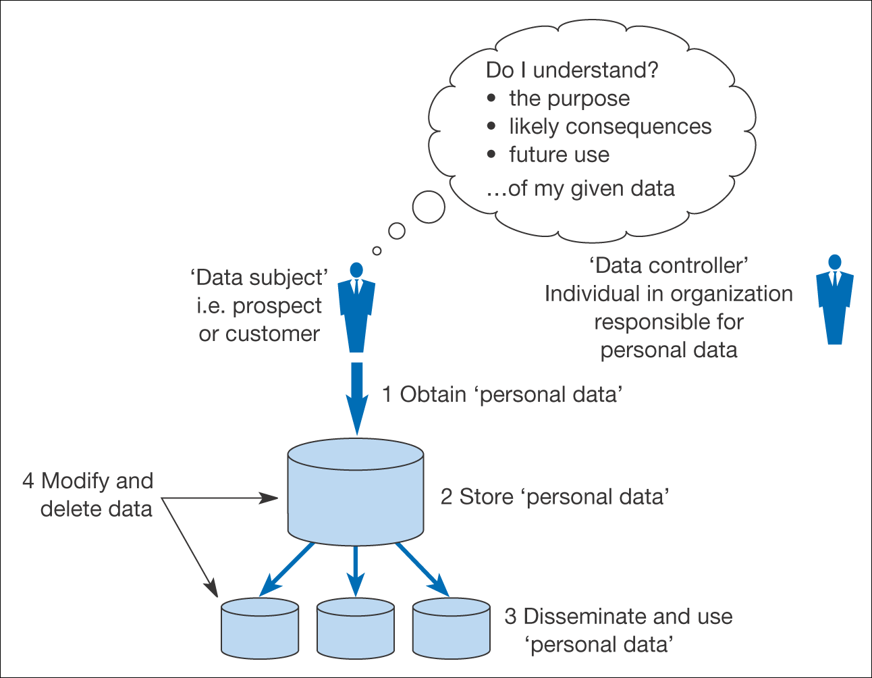
Figure 4.7 Information flows that need to be understood for compliance with data protection legislation

Slide 18
Legal – Sparrows eight areas
Marketing your e-commerce business
Forming an electronic contract
Making and accepting payment
Authenticating contracts concluded over the Internet
E-mail risks
Protecting Intellectual Property
Advertising on the Internet
Data protection.

Slide 19
Economic/Political
Ensuring companies competitive
  Funding for education and technology
  Promoting new technology e.g. broadband 12% in UK, 70% Taiwan, South Korea
Achieving government efficiencies
  E-government – all UK services online by 2005
  Singapore ‘Intelligent Island’
Taxation regimes
  Legislation for offshore trading.

Slide 20
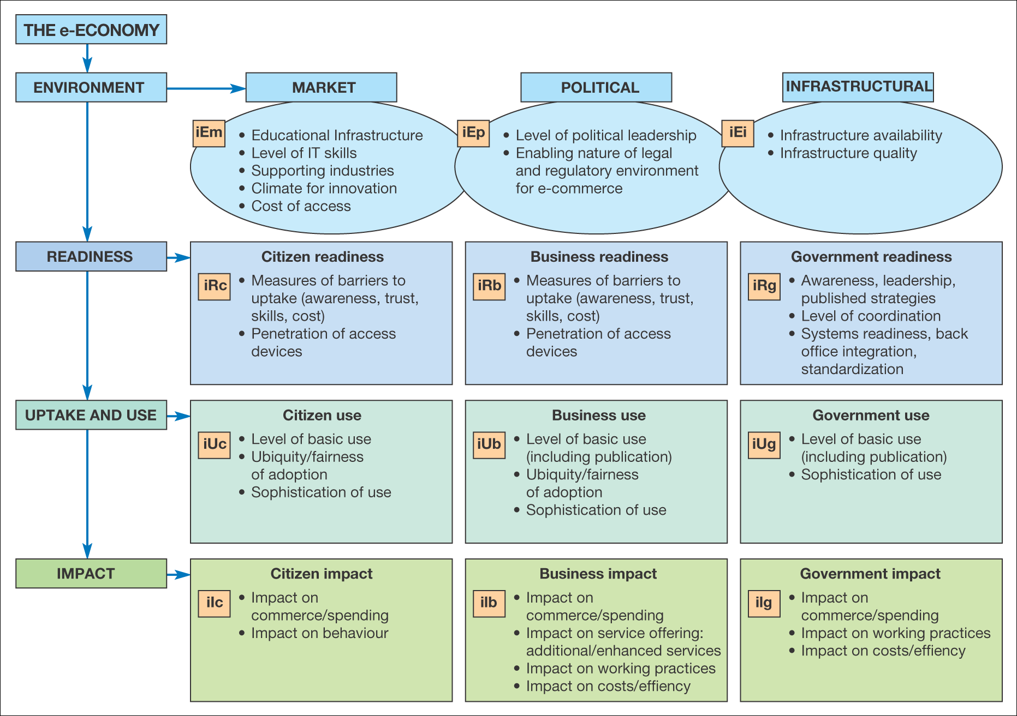
Figure 4.8 A framework describing the e-economy
Source: Booz Allen Hamilton (2002). International E-Economy: Benchmarking The World’s Most Effective Policy for the E-Economy. Report published 19 November, London.
www.e-envoy.gov.uk/oee/oee/nsf/sections/summit_benchmarking/$file/indexpage.htm © Crown copyright 2002

Slide 21
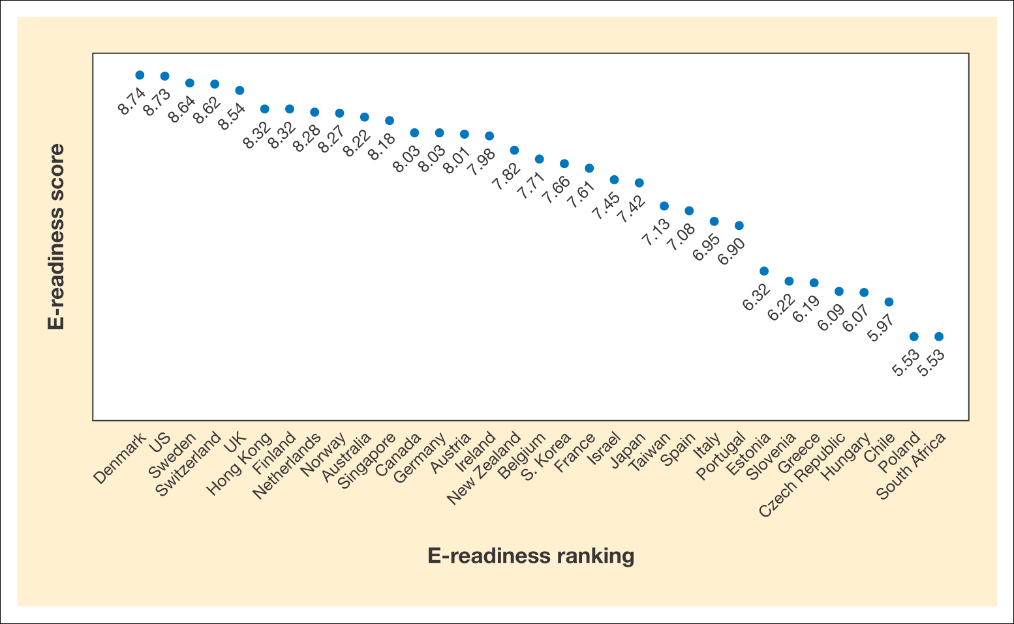
Figure 4.9 Leaders and laggards in e-commerce
Source: © 2005 Adapted from Economist Intelligence Unit data © 2005, Economist Intelligence Unit

Slide 22
Technological issues
Rate of change
  Which new technologies should we adopt?
    Monitoring for new techniques
    Evaluation – are we early adopter
    Re-skilling and training
Are our systems secure?

Slide 23
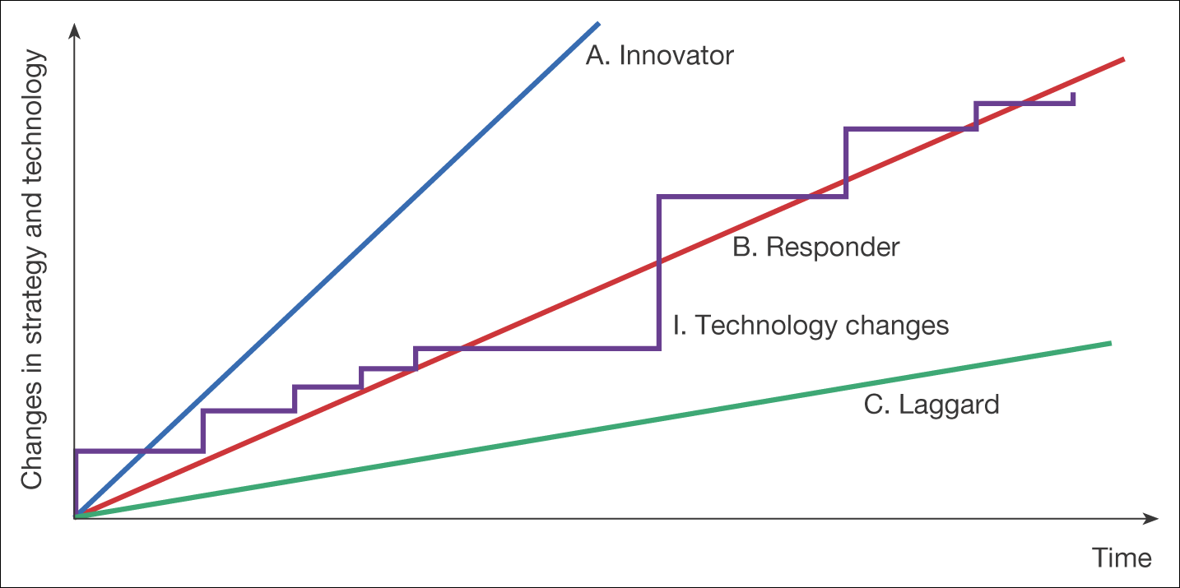
Figure 4.12 Alternative responses to changes in technology

